Slide 1

Rockbuster Stealth LLC – Important Findings
Myra Ahsan, 10/2/2023

Slide 2
What are we looking for?
Goal: To launch an online video rental service
Motivation: most/least revenue gain from movies + average rental duration for all videos + geographical location of Rockbuster customers + sales figures according to location
Objective: Understand the best strategy to launch the Rockbuster rental service

Slide 3
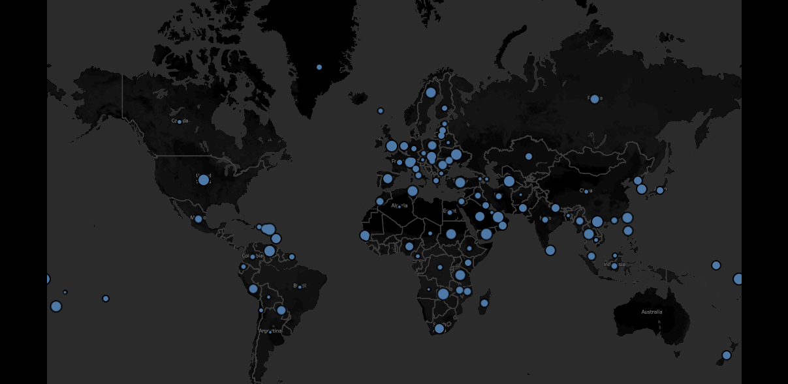

Rockbuster has
599 customers from all over the world
URL: Link to Tableau Public

Slide 4
Highlights from the analysis
Average rental duration of all movies was around
5 days
The movies have been rented 16044 times overall
Only English language movies are available in Rockbuster’s movie library
The most popular movies rating wise
PG-13
There are a total of 1000 movies that can be rented

Slide 5
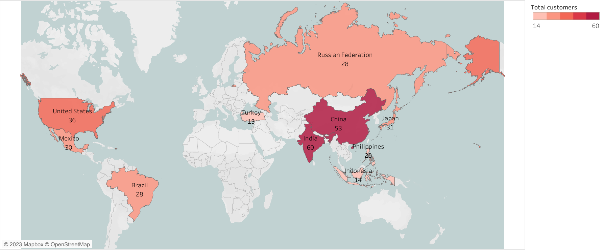
Top 10 countries with the highest number of customers
India & China have the most customers
URL: Map link to Tableau Public

Slide 6
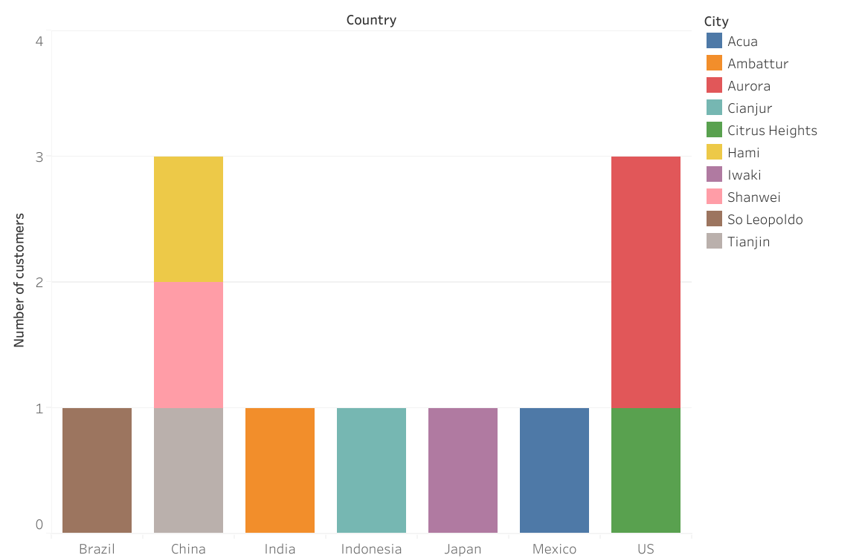
The stacked bar chart shows the top 10 cities among the top countries where there are the most customers for Rockbuster
Three customers reside in three separate cities of China
Two customers live in Aurora – a city in the US while one lives in Citrus Heights
URL: Link to Tableau Public

Slide 7
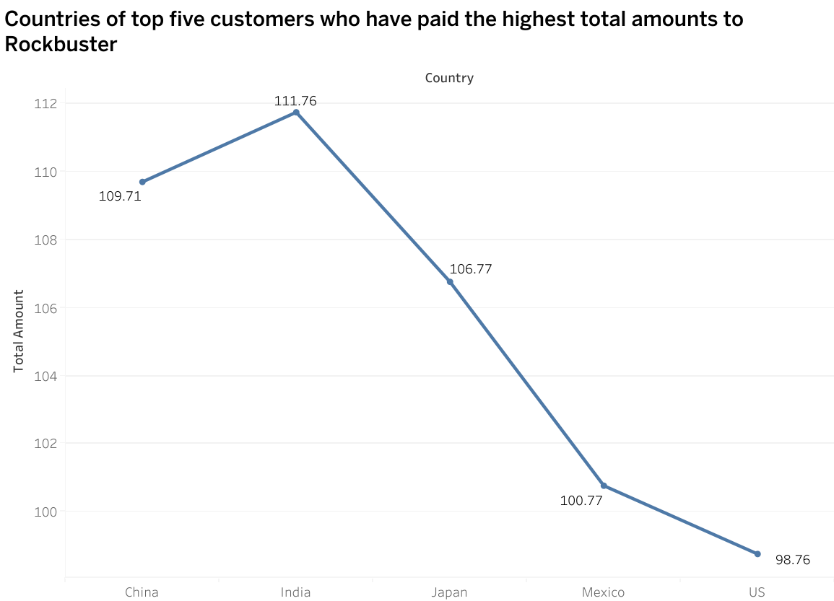
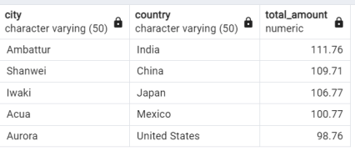
The customer who has paid the highest total amount to Rockbuster is from Ambattur, India
For data privacy, names of customers have not been added in the presentation
URL: Link to Tableau Public

Slide 8
Most popular category of movies
Sports, Sci-Fi, Animation & Drama are the most popular categories of movies that were rented
$47.89 was collected from Thriller movies, which was the least popular

Slide 9
Recommendations
Invest more in India, China and the US – the countries with the most customers
Introduce movies in other languages for non-English speaking audiences
Introduce more PG-13 movies, since that was the most popular rated movies
Further analysis need to be done to reflect and understand why Thriller movies are barely in demand
The top five customers of Rockbuster should be given a reward to ensure those customers keep using the service e.g. discount coupons, loyalty card scheme etc
More investment needs to be made for marketing campaigns in countries where the demand for Rockbuster’s services are the lowest

Slide 10

QUESTIONS?
Myra Ahsan | myra******@hotmail.com

